Slide 1

Online Job Portal

Slide 2
Team Members
Roll No. | Team Members Name
59 | Sakshi Santosh Nagarkar
45 | Aditya Sanjaykumar Waykos
48 | Sammed Mangalchand Singalkar
17 | Sanket Sanjay Raone

Slide 3
Database Design Phases
Phase-I: Textual Description (Specification of user requirements)
Phase-II: E-R Diagram (Conceptual-design phase)
Phase-III: Specification of functional requirements
Phase-IV: Reduction of E-R Diagram to Relational Schema (Logical
Design)

Slide 4
Phase-I: Textual Description (Specification of user requirements)
Database design for online job portal
-> Online job portal consists of company. each company is identified by unique id(company_id).
company also has company_name, pin code, website_url, establishment date, company stream,
Location
-> Online job portal system consists of job with unique id (job_id).
also consists of number of vacancies, company_name, date and time, location.
-> Each job_seeker applying to specific company.
Each job_seeker is identified by job_seeker_id as a unique id.
it also consists of name, email_id, contact details, Date of Birth, Gender, Password.
-> Online Job Portal System organizes an interview for each job_seeker.Each interview associated
with unique id(interview_id). it is also associated with Company name, Interviewee, Interview
type, Interview place, Interviewer name, Interview date.
-> Registration are indentified by their unique id(registration id). Each registration has
Registration name, Company name,Date and time,Type and Description.
-> Resume is compulsory for each job_seeker which is associated with Application id, Upload,
Experience level,Qualification.
-> Administrator manages job_seeker. Each administrator has unique id(Email_id).
it also consists of user_name, password, responsibilities.

Slide 5
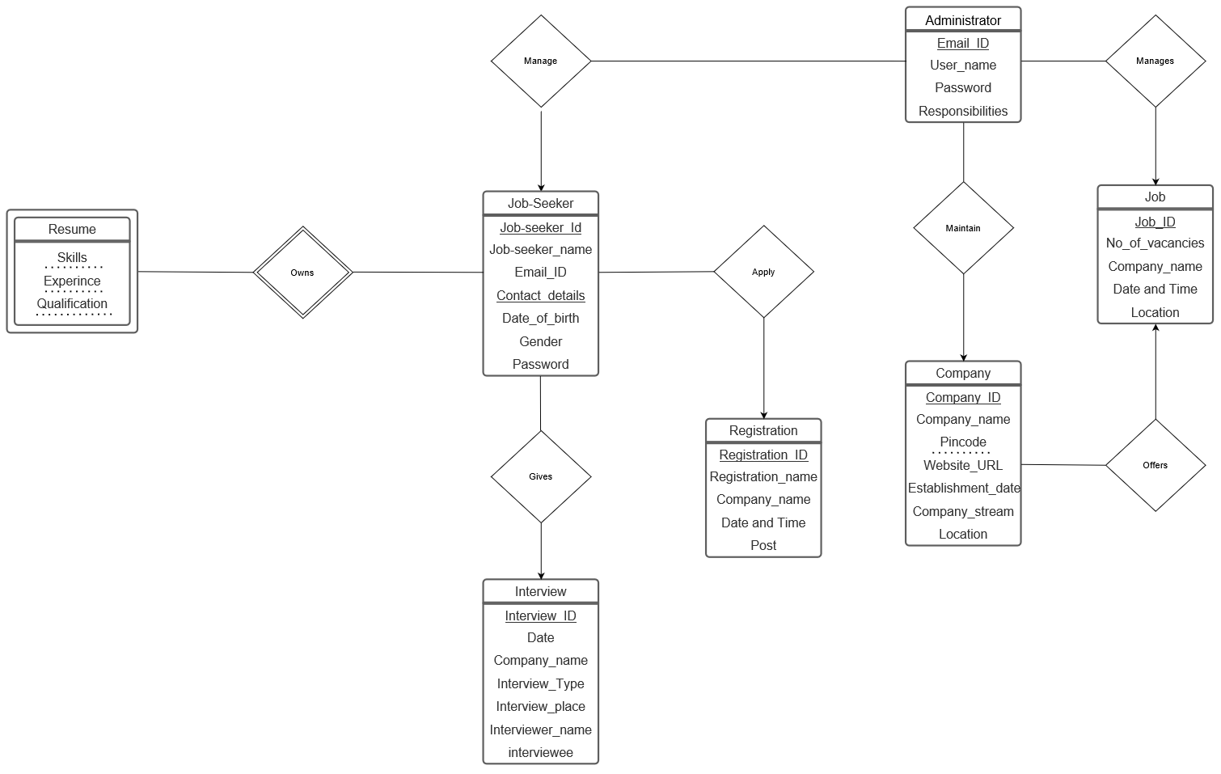
Phase-II: E-R Diagram (Conceptual-design phase)

Slide 6
Phase-II: E-R Diagram (Conceptual-design phase)
The schemas derived from entity sets are:
->Company(Company_id, company_name, pin code, website url,
establishment date, company stream, location.)
->Job(Job_id, number of vacancies, company_name, date and time, location.)
->Job_seeker(Job_seeker_id, email_id, contact details, Date of Birth, Gender, Password.)
->Interview(Interview_id, Company name, Interviewee, Interview type, Interview place, Interviewer name, Interview date.)
->Registration(Registration_id, Company name, Interviewee, Interview
type, Interview place, Interviewer name, Interview date.)
->Resume(Application id, Upload, Experience level,Qualification.)
->Administrator(Email_id, user_name, password)

Slide 7
Relationship Sets
The schemas derived from entity sets are:
1)apply (Job-seeker_id, Registration_no)
2)own (Job-seeker_id, Qualification ,
Experince, Skills)
3)gives (Job-seeker_id, Interview_id)
4)offers (Company_id, Job_id)
5)manage (Email_id, Job-seeker_id)
6)manages (Email_id, Job_id)
7)maintain (Email_id, Company_id)

Slide 8
Phase-III: Specification of functional requirements
Specification of functional requirements
Add/ remove /update job-seeker record.
Find the job with maximum no of vacancies.
Find the list of job-seeker with CSE B-tech degree.
Find the companies with IT stream.
Find the Job with highest salary.
Find the companies with location mumbai.

Slide 9
Phase-IV: Reduction of E-R Diagram to Relational Schema
Registration Relation
Primary key:
Registration_no
Registration_no | Registration_name | Company_name | Date and Time | Post
1919135 | Swati Annadate | TCS | 05/10/2021 | Software Developer
1919136 | Sakshi Jain | Infosys | 21/10/2021 | Data Scientist
1919137 | Harsh Wakle | Tata Motors | 26/10/2021 | Manager
1919138 | Shital Soni | Byju’s | 01/11/2021 | Professor
1919139 | Urvashi Uttarwar | Zomato | 25/10/2021 | Application Manager
1919140 | Kalpesh Deshmukh | Jio | 30/10/2021 | Website Manager

Slide 10
Phase-IV: Reduction of E-R Diagram to Relational Schema
Company Relation
Primary key:
Company_id
Company_name | Company_ID | Pincode | establishment_date | Website_url | Company_stream | Location
TCS | 110216 | 400001 | 01/04/1968 | TCS.com | IT | Mumbai
INFOSYS | 400054 | 560100 | 02/06/1981 | infosys.com | IT | Bengaluru
TATA MOTORS | 112035 | 400001 | 01/03/1945 | tatamotors.com | Automobile | Mumbai
ZOMATO | 192463 | 110019 | 18/01/2008 | zomato.com | Food delivery | New Delhi
BYJU’S | 200213 | 560029 | 01/03/2011 | byjus.com | Education | Bengaluru
JIO | 456322 | 400021 | 10/05/2007 | jio.com | Telecom | Mumbai

Slide 11
Phase-IV: Reduction of E-R Diagram to Relational Schema
Resume Relation
Primary key:
Job_seeker_id
Job_Seeker_ID | Qualification | Experience | Skills
40021 | B.tech CSE Intern @microsoft | Fresher | Programming, Leadership
40022 | B.tech ME M.tech ME | 5 Years | Team Work, Communication
40023 | Master in Business Administration | Fresher | Creativity, Management
40024 | B.Ed Mathematics | Fresher | Motivation, Communication
40025 | M.tech IT | 2 years | Decision Making, Problem Solving
40026 | BCA | Fresher | Programming, Team Work

Slide 12
Phase-IV: Reduction of E-R Diagram to Relational Schema
Job Seeker Relation
Primary key:
Job_seeker_id
Job_seeker_ID | Applicant_name | Email_ID | Gender | Contact_details | Date_of_birth | Password
40021 | Swati Annadate | swatiannadate@gmail.com | Female | 9456872361 | 02/05/2000 | Swati@123
40022 | Sakshi Jain | jainsakshi1@yahoo.in | Female | 8495682130 | 14/07/1991 | Sakshi@jain34
40023 | Harsh Wakle | wakleharsh@gmail.com | Male | 7496853749 | 26/11/1996 | harsh12wakle
40024 | Shital Soni | shitalsoni@gmail.com | Female | 8895643015 | 16/08/2000 | Soni11@shital43
40025 | Urvashi Uttarwar | urvashiuttarwar@gmail.com | Female | 7979765122 | 30/05/1995 | urvautt78
40026 | Kalpesh Deshmukh | deshmukhkd@gmail.com | Male | 7879764565 | 05/05/2000 | kd47mukh

Slide 13
Phase-IV: Reduction of E-R Diagram to Relational Schema
Job Relation
Primary key:
job_id
Job_ID | No_Of_Vacancies | Company_name | Salary | Skills_required | Job_location_city
9090 | 54 | TCS | 4.5 LPA | Programming, Leadership | Mumbai
9091 | 60 | Infosys | 8 LPA | Team Work | Bengaluru
9092 | 34 | Tata Motors | 5 LPA | Management | Mumbai
9093 | 45 | Byju’s | 7 LPA | Communication | New Delhi
9094 | 59 | Zomato | 6 LPA | Decision Making and Problem Solving | Bengaluru
9095 | 21 | Jio | 10 LPA | Team Work, Programming | Mumbai

Slide 14
Phase-IV: Reduction of E-R Diagram to Relational Schema
Administrator Relation
Primary key:
password
User_name | Password | Email_ID | Responsibilities
Sakshi_Nagarkar | Sakshi@01 | sakshinagarkar2001@gmail.com | Dealing Queries
Aditya_Waykos | Aditya@01 | aswaykos@gmail.com | Maintaining Website
Sammed_Singalkar | Sammed@02 | singalkarsammed@gmail.com | Arranging Travels
Sanket_Raone | Sanket@02 | raonesanket@gmail.coom | Maintaining Server

Slide 15
Phase-IV: Reduction of E-R Diagram to Relational Schema
Interview Relation
Primary key:
interview_id
Interview_ID | Interview_date | Company_name | Interview_type | Interviewer_name | Interviewee | Interview_place
1001 | 07/11/2021 | TCS | Online | Mrs. Mansi Shah Mr. Manoj Dhale | Swati Annadate | Pune
1002 | 07/11/2021 | Infosys | Offine | Mr. Rajesh Kumar Mr. Dev Datta Mr. Nikhil Jain | Sakshi Jain | Mumbai
1003 | 08/11/2021 | TATA MOTORS | Online | Mr. Aditya Jain Mrs. Vishal Yogi | Harsh Wakle | Aurangabad
1004 | 10/11/2021 | Byju’s | Online | Mrs. Samiksha Patil Mrs. Harshit Kumar | Shital Soni | Kolkata
1005 | 11/11/2021 | Zomato | Offline | Mr. Rajesh Kumar Mrs. Kritika Doiphode | Urvashi Uttarwar | Hydrabad
1006 | 20/11/2021 | Jio | Offline | Mrs. Swati Kulkarni Mr. Raghu Rajput | Kalpesh Deshmukh | Pune

Slide 16
Apply Relation
Primary key : {Job_seeker_ID)
Foreign key: {Job_seeker_ID} referencing the primary key of the Job_seeker relation and {Registration_no} referencing the primary key of the Registration relation
Job_Seeker_ID | Registration_no
40021 | 1919135
40022 | 1919136
40023 | 1919137
40024 | 1919138
40025 | 1919139
40026 | 1919140

Slide 17
Gives Relation
Primary key:
{Job_seeker_ID)
Foreign key: {Job_seeker_ID} referencing the primary key of the Job_seeker relation and {Interview_ID} referencing the primary key of the Interview relation
Job_seeker_ID | Interview_ID
40021 | 1001
40022 | 1002
40023 | 1003
40024 | 1004
40025 | 1005
40026 | 1006

Slide 18
Offers Relation
Primary key : {Company_ID}
Foreign key: {Company_ID} referencing the primary key of the Company relation and {Job_ID} referencing the primary key of the Job relation
Company_ID | Job_ID
110216 | 9090
400054 | 9091
112035 | 9092
192463 | 9093
200213 | 9094
456322 | 9095

Slide 19
Owns Relation
Primary key : {Job_seeker_ID}
Job_seeker_ID
40021
40022
40023
40024
40025
40026

Slide 20
Manage Relation
Primary key : {Job_seeker_ID}
Job_seeker_ID
40021
40022
40023
40024
40025
40026

Slide 21
Manages Relation
Primary key : {Job_ID}
Job_ID
9090
9091
9092
9093
9094
9095

Slide 22
Maintain Relation
Primary key : {Company_ID}
Company_ID
110216
400054
112035
192463
200213
456322

